Slide 1
Class 02 - Filtering and analyzing Dataframes
Subset
By Columns
By Rows
Exercise 1
Exercise 2

Slide 2
How do I select a subset of a DataFrame?
Subset:
https://pandas.pydata.org/docs/getting_started/intro_tutorials/03_subset_data.html

Slide 3
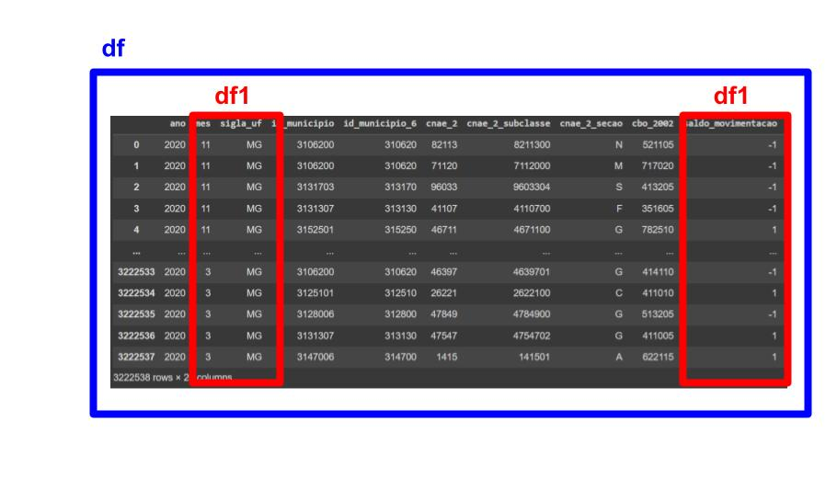
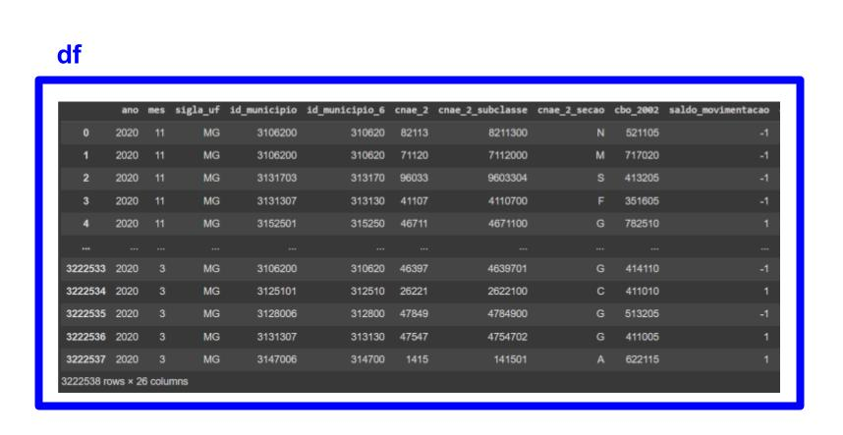
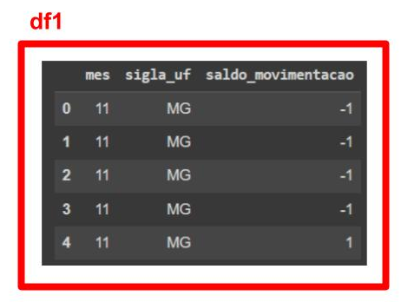
with .copy()
Without .copy()

Slide 4
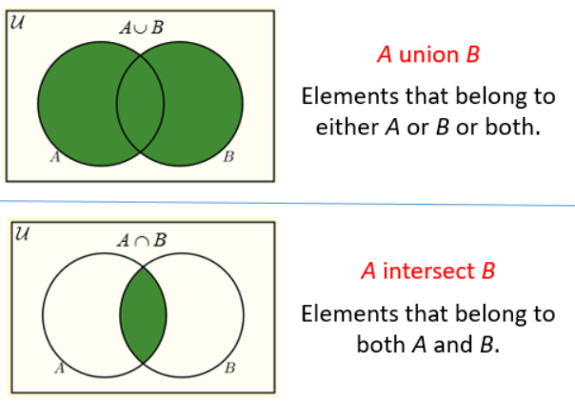
Filter by multiple conditions

Slide 5
Exercise 1:
1. Select from original df the following columns and assign them into a new df (ex. df1):
mes,
id_municipio,
saldo_movimentacao,
cnae_2_secao
salario_mensal
descricao_ocupacao
2. Choose from caged’s layout.xlsx:
i) one municipio id from 'município' worksheet;
ii) one “description” from ‘descricao_ocupacao’
3. Filter dataframe rows by:
selected 'municipio' id,
Descricao_ocupacao (test some occupations you have in mind)
(startswith, contains, endswith) 🡪 use your imagination!!!
4. Extract some statistic information

Slide 6
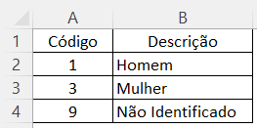
Exercise 2:
Class example:
Exercise:
Replace values in column ‘sexo’ with their labels

Slide 7
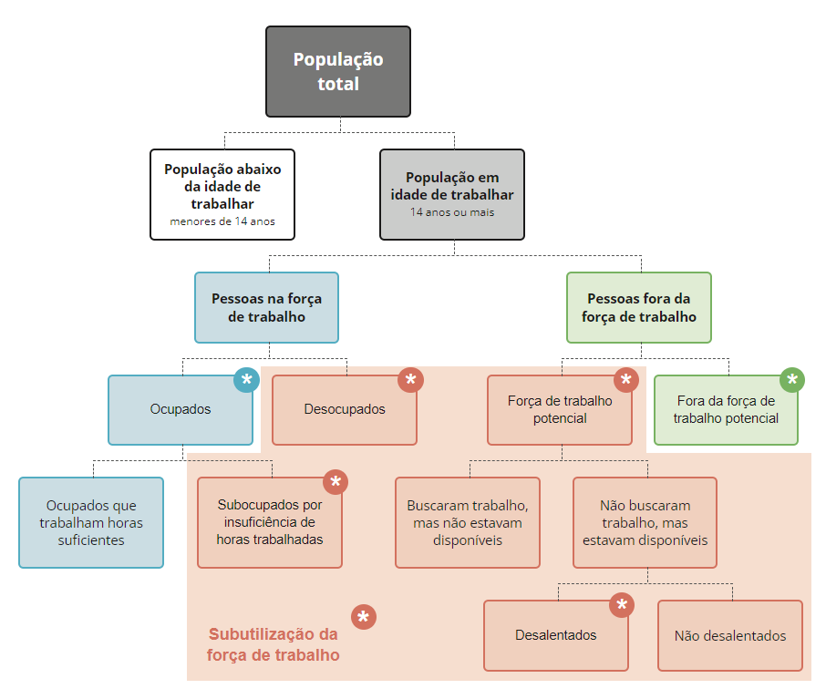
Flowchart IBGE
Notes:
https://www.ibge.gov.br/explica/desemprego.php

